Slide 1
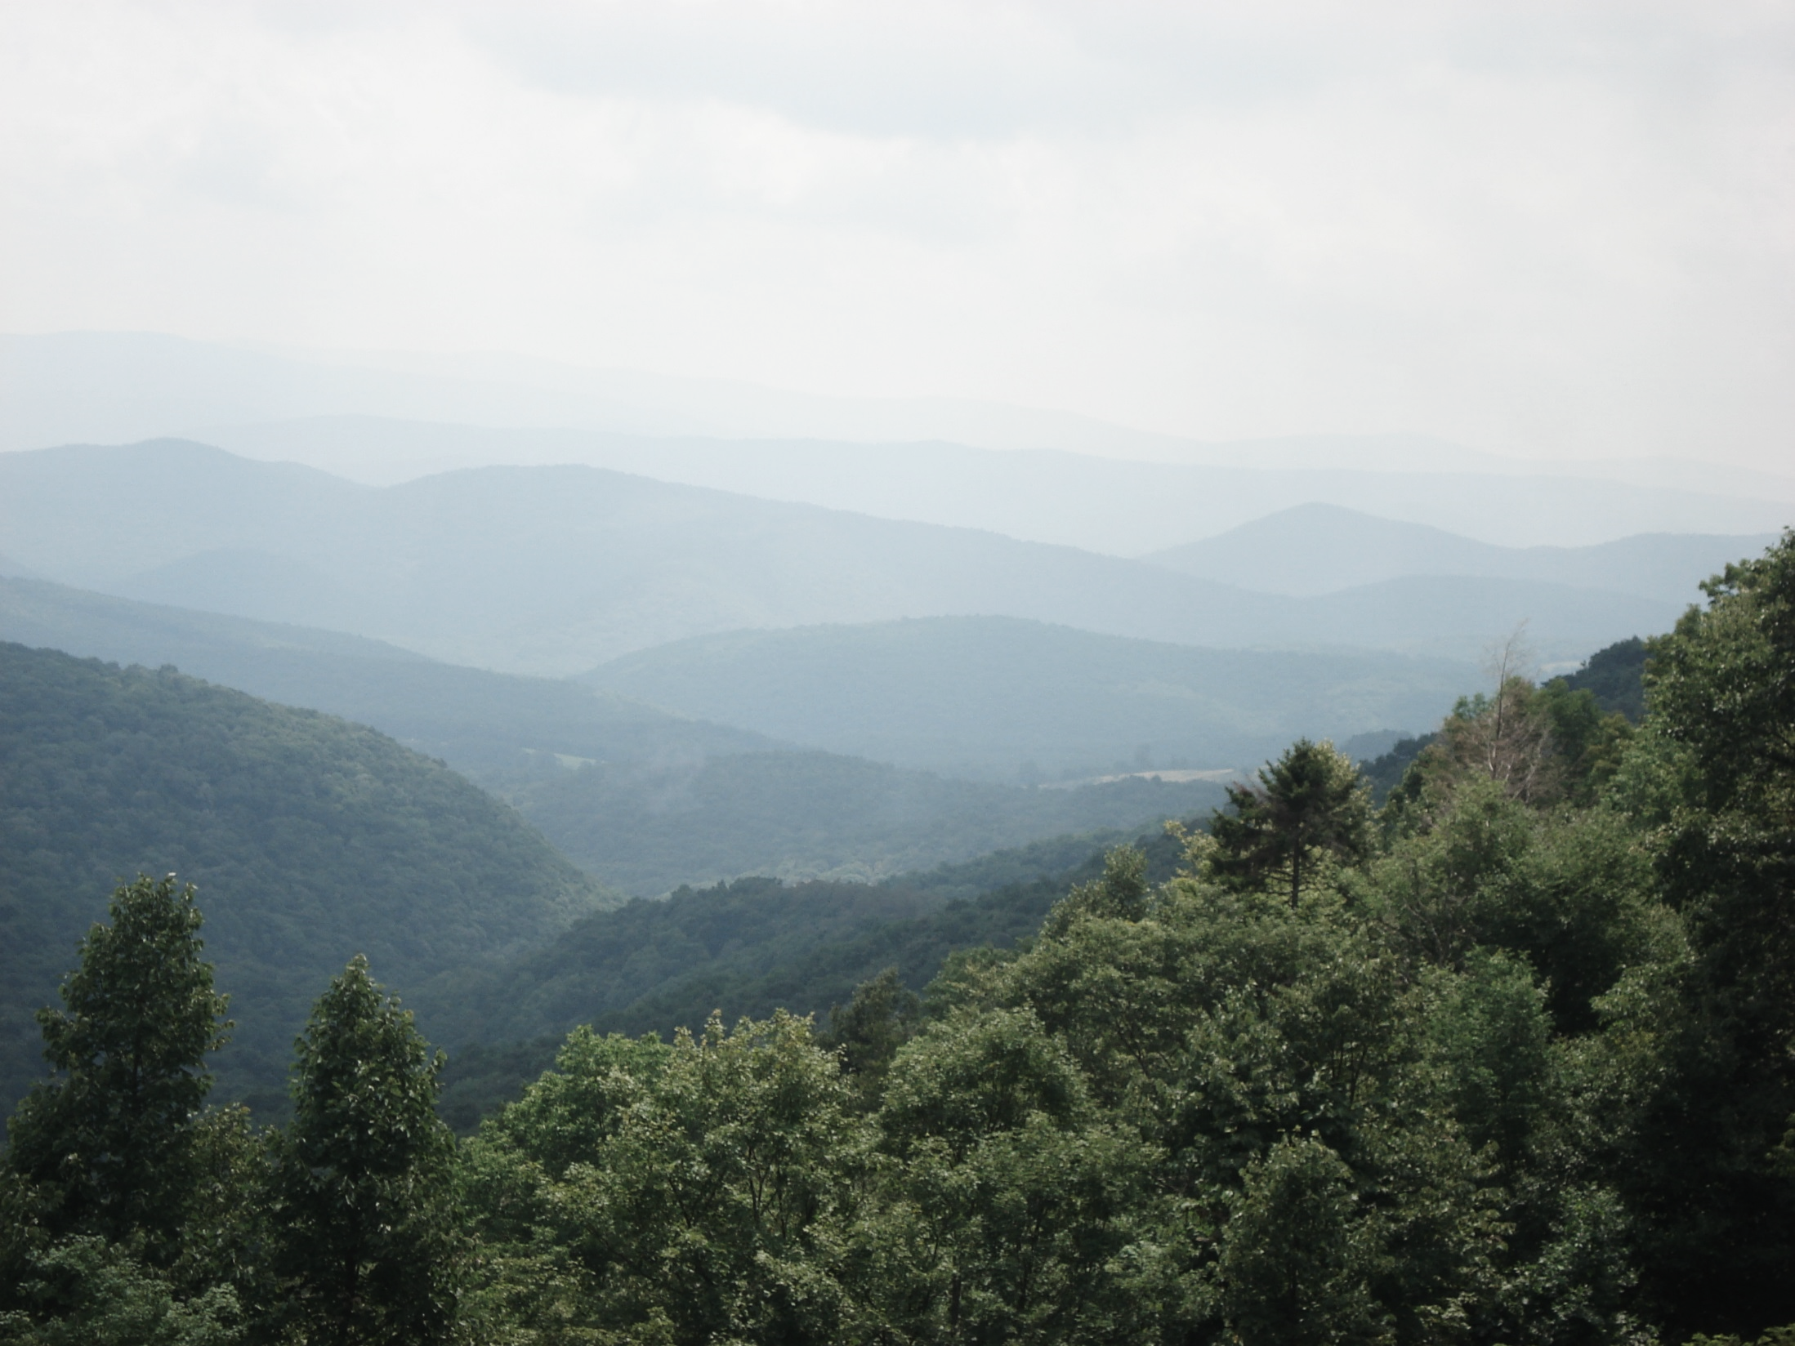
Tree-based Models
Presented by: Katey Yoast

Slide 2
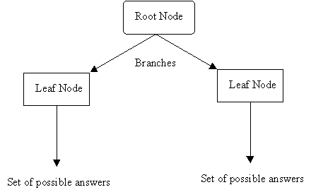
What is a Decision Tree?
Instead of fitting a model to the data, a decision tree model recursively partitions the data into increasingly homogenous groups based on values that minimize a loss function (such as Sum of Squared Errors (SSE)) (McBratney et al., 2003).
Terminal Node
Terminal Node
Source: http://www2.cs.uregina.ca/~dbd/cs831/notes/ml/dtrees/4_dtrees1.html
Notes:
How have you, or could you, use decision trees?

Slide 3
Example
Argillic Horizon
No
Yes
Dominant Vegetation
Base Saturation
Hardwood
Conifer, Mixed
<35%
>35%
Inceptisols
Spodosols
Ultisols
Alfisols

Slide 4
Advantages of Tree-based Models
Closely resemble human reasoning
Quick to execute
Do not assume or require normality
Can handle categorical AND continuous data
Offer readily interpretable results, often including graphical and tabular outputs
Can be used for classification OR regression
Can handle missing values
Can be used for exploratory data analysis AND prediction

Slide 5
Two Most Common Tree-based Models in R
Recursive Partitioning (rpart)
Produces a regression or classification tree based on recursive binary splits that maximize homogeneity and minimize impurity.
Random Forest (randomForest)
Produces an ensemble of independent trees (regression or classification) that are built using a random subset of observations that are then split using a random subset of predictors at each node.

Slide 6
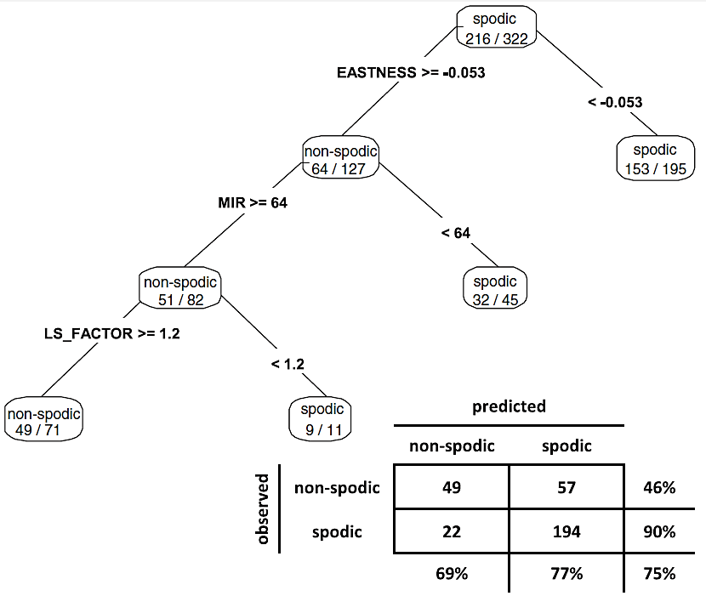
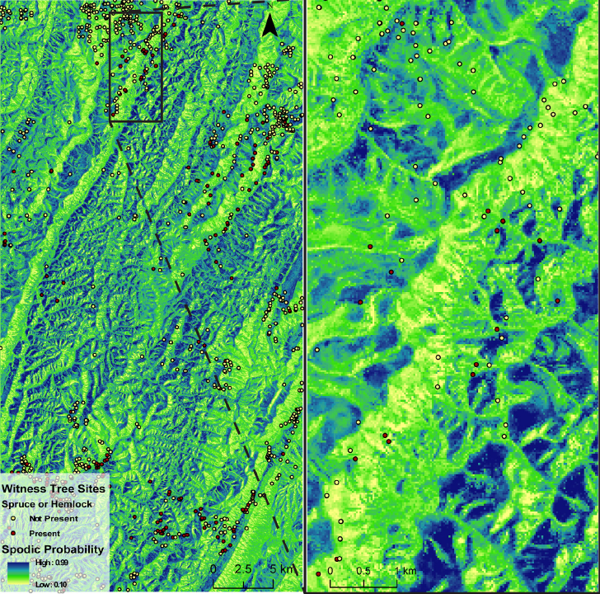
Nauman et al., 2015
Notes:
Rpart Example – spodic probability (to aid in interpretation). Interpolated random forest model.

Slide 7
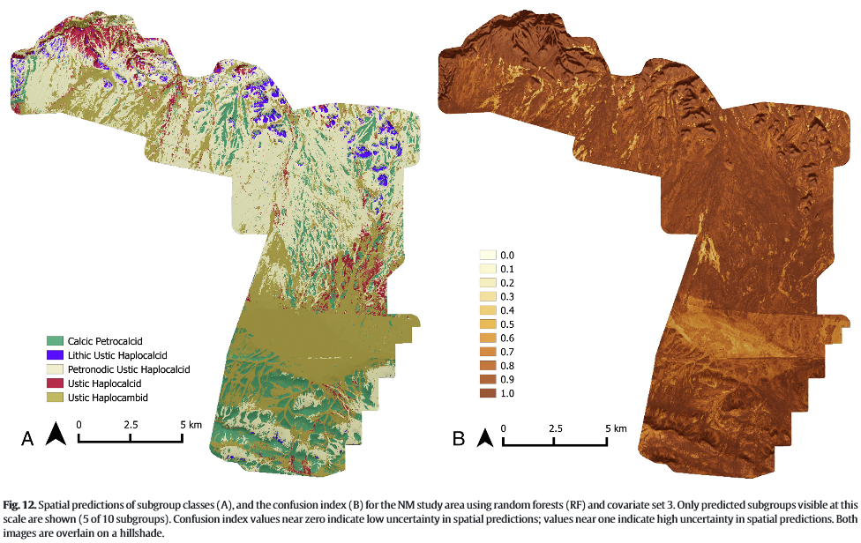
Brungard et al., 2015
Notes:
Brungard et al., 2015 compared many different machine learning techniques in 3 semi-arid regions, including knn, linear discriminant analysis, multinomial logistic regression, classification tree, support vector machines, etc., and found random forest to perform the best for soil taxonomic class prediction. This figure shows the interpolated RF model on the left and confusion index on the right. When presenting interpolated models, it is always best to include an interpolated confusion index to show where the model strengths and weaknesses are.
Sequeira et al., 2014 and Yoast, 2015 successfully used RF as a pedotransfer function to populate missing bulk density and carbon data.

Slide 8
rpart algorithm
Start with all cases at the root node and select the variable/value (X=t₁) that best splits the data into homogeneous groups (sum of squared errors for regression and entropy, Gini measure, or “twoing” for classification).
If X< t₁ then the data are sent to the left; otherwise, the data are sent to the right.
Repeat this process until the objective is met.
Comments:
Once the cases are split, they are never rejoined
A given variable can be used multiple times in a tree
Pruning may be necessary to reduce over-fitting
Notes:
Tree grows upside down with root at top

Slide 9
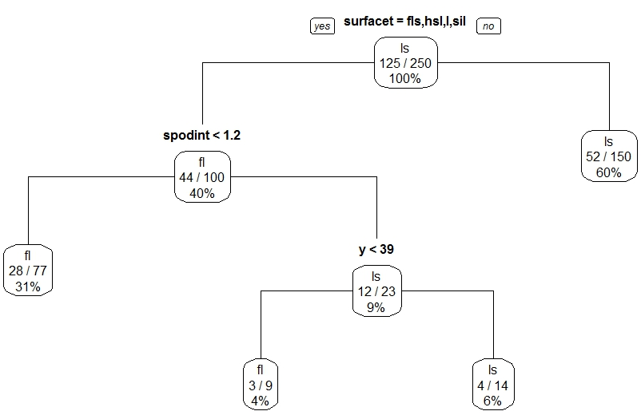
rpart – Classification Trees
Terminal nodes are categorical -- the class with the majority of votes wins.

Slide 10
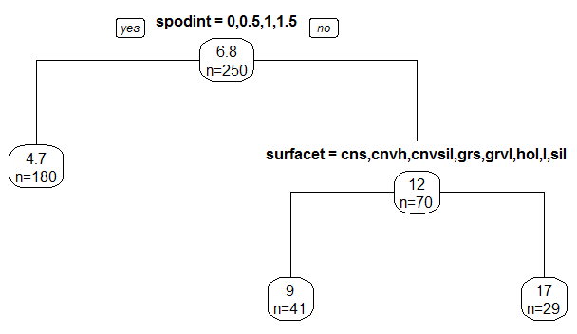
rpart – Regression Trees
Terminal nodes represent the mean of the observations in that node.

Slide 11
EXERCISE: rpart
https://github.com/ncss-tech/stats_for_soil_survey/blob/master/chapters/8_Tree_models/treemodels.md

Slide 12
Summary - rpart
rpart(formula, data, method, control)
formula response~predictor1+predictor2+predictorx
data= specifies the dataset
method= “class” for classification tree
“anova” for regression tree
control= optional parameters for controlling tree growth
printcp( ) | displays complexity parameter (cp) table
plotcp ( ) | plots cross-validation results
summary ( ) | detailed results including surrogate splits
plot ( ) | plots the decision tree
text ( ) | labels the decision tree plot
prune ( ) | snips off the least important splits using cp
rpart.plot ( ) prp ( ) | located in the rpart.plot package, these commands allow for better rpart plot customizations

Slide 13
randomForest algorithm
Grow a forest of many trees (ntree).
Grow each tree from an independent bootstrap sample from the training data (sample N cases at random with replacement).
For each tree at each node:
Select a random subset of predictor variables (mtry)
Use the best split on the selected mtry variables
Repeat this process until the tree is grown to the largest extent possible (no pruning)
Aggregate all trees for prediction (average for regression, majority vote for classification).
Notes:
Does not produce a single tree output like rpart because decisions are not made on a single binary tree….decisions are made using an ensemble of trees.

Slide 14
Variable Importance
The importance of each variable is estimated by observing how much the prediction error increases when out-of-bag (OOB) data for that variable are permuted while all others are left unchanged.

Slide 15
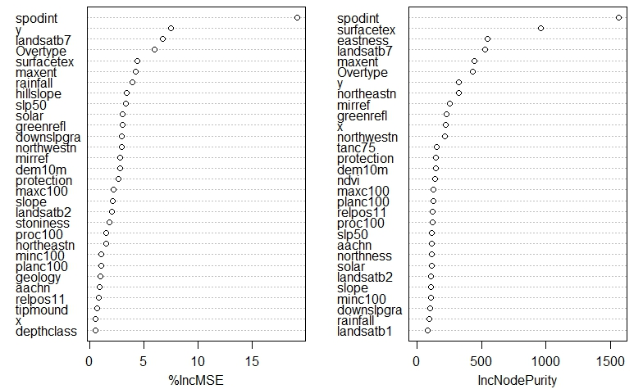
Variable Importance: Regression

Slide 16
Regression Terms
%Inc MSE
average increase in squared residuals of the test set when variables are randomly permuted (little importance = little change in model when variable is removed or added)
Inc Node Purity
increase in homogeneity in data partitions
Mean of Squared Residuals
sum of squared residuals divided by n
% Variance Explained
psuedo R²

Slide 17
Classification Terms
Mean Decrease Accuracy
the more the accuracy of the random forest decreases due to the addition of a single variable, the more important the variable is deemed
Mean Decrease Gini
a measure of how each variable contributes to the homogeneity of the nodes and leaves
Out of Bag Error
proportion of times that the result is misclassified, averaged over all samples

Slide 18
Classification Terms – Confusion Matrix
Producer’s accuracy
How well a certain area can be classified (omission error)
User’s accuracy
Reliability, probability a pixel class on the map
represents the category on the ground (commission
error)
Overall accuracy
Dividing the total number of correct pixels
(diagonal) by the total number of pixels in the error
matrix
Source: http://web.pdx.edu/~jduh/courses/Archive/geog481w07/Students/Mckay_AccuracyAssessment.pdf

Slide 19
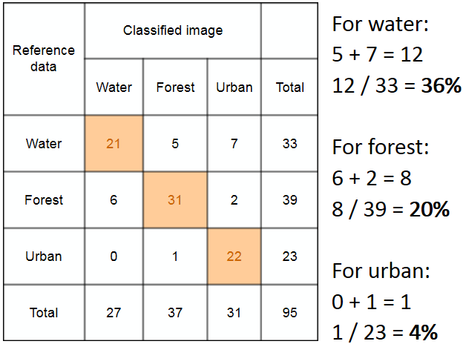
Producer’s Accuracy
Source: http://slideplayer.com/slide/4402010/
Notes:
Producer’s accuracy = 100 – omission error = how often are real features in the field correctly shown on the map?

Slide 20

User’s Accuracy
Source: http://slideplayer.com/slide/4402010/
Notes:
User’s accuracy = 100 – commission error = how often is the class on the map actually truthful in reality

Slide 21
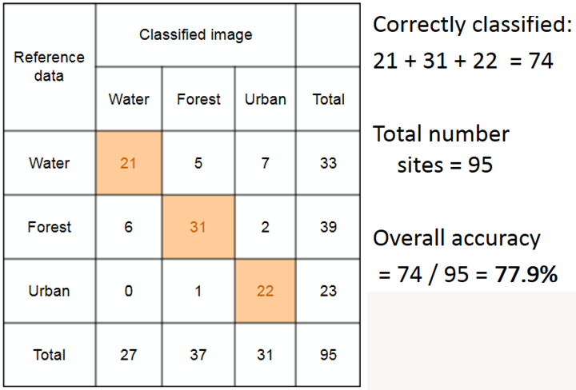
Overall Accuracy
Source: http://slideplayer.com/slide/4402010/
Notes:
Of all the reference sites, how many were mapped correctly?

Slide 22
EXERCISE: randomForest
https://github.com/ncss-tech/stats_for_soil_survey/blob/master/chapters/8_Tree_models/treemodels.md

Slide 23
Summary - randomForest
randomForest(formula, data, importance)
formula response~predictor1+predictor2+predictorx
data= specifies the dataset
mtry= number of randomly sampled variables at
each node
ntree= number of trees to grow
importance= if TRUE, allows user to examine variable importance
varImpPlot ( ) | variable importance plot
importance ( ) | variable importance statistics
plot ( ) | plots out of bag (OOB) error rate versus number of trees
print( ) | model summary statistics

Slide 24
Summary – Tree Models
Tree-based models are quick, intuitive, nonparametric, and are often ideal for exploratory data analysis and prediction
Both rpart and randomForest packages perform internal validation (rpart=10-fold cross validation; randomForest=OOB error estimates)
In general, tree-based models are robust against multicollinearity and low n, high p datasets
Caveats
Outliers (model stability and over-fitting)
Model parameters (pruning for rpart; ntree and mtry for randomForest)

Slide 25

Always Remember…
“The combination of some data and an aching desire for an answer does not ensure that a reasonable answer can be extracted from a given body of data.”
–John Tukey
http://www.amstat.org/about/statisticiansinhistory/index.cfm?fuseaction=biosinfo&BioID=14

Slide 26
Review Questions
Why is random forest often referred to as double random?
How does random forest perform internal validation?
True or false – numerical and categorical data can be used in the creation of a classification tree?
What are some differences between rpart and randomForest?
Why is random forest often referred to as double random?
How does random forest perform internal validation?
True or false – numerical and categorical data can be used in the creation of a classification tree?
What are some differences between rpart and randomForest?
Why is random forest often referred to as double random?
How does random forest perform internal validation?
True or false – numerical and categorical data can be used in the creation of a classification tree?
What are some differences between rpart and randomForest?
Why is random forest often referred to as double random?
How does random forest perform internal validation?
True or false – numerical and categorical data can be used in the creation of a classification tree?
What are some differences between rpart and randomForest?

Slide 27
References
Brungard, C.W., J.L. Boettinger, M.C. Duniway, S.A. Wills, T.C. Edwards Jr. 2015. Machine learning for predicting soil classes in three semi-arid landscapes. Geoderma. 239-240, 68-83.
Nauman, T.W., J.A. Thompson, S. J. Teets, T.A. Dilliplane, J.W. Bell, S.J. Connolly, H.J. Liebermann, K.M. Yoast. 2015. Ghosts of the forest: mapping pedomemory to guide forest restoration. Geoderma. 247-248, 51-64.
Sequeira, C.H., S.A. Wills, C.A. Seybold, and L.T. West. 2013. Predicting soil bulk density from incomplete datasets. Geoderma. 213: 64-73.

